Slide 1
Parallel Graph Partitioning and Randomized Linear Algebra
Erik G. Boman
Seher Acer
Heliezer Espinoza
Jennifer Loe
ACDA Workshop, Aussois
Sept. 5-9, 2022

Slide 2
Sphynx – Highlights
Sphynx: Spectral Partitioning for HYbrid aNd aXelarator-based systems
Sphynx uses several Trilinos packages using Kokkos for performance portability
Sphynx is the first multi-GPU partitioner for distributed-memory systems
Compared to ParMETIS, Sphynx is faster on irregular graphs and obtains similar quality partitions on regular graphs

Slide 3
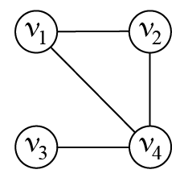
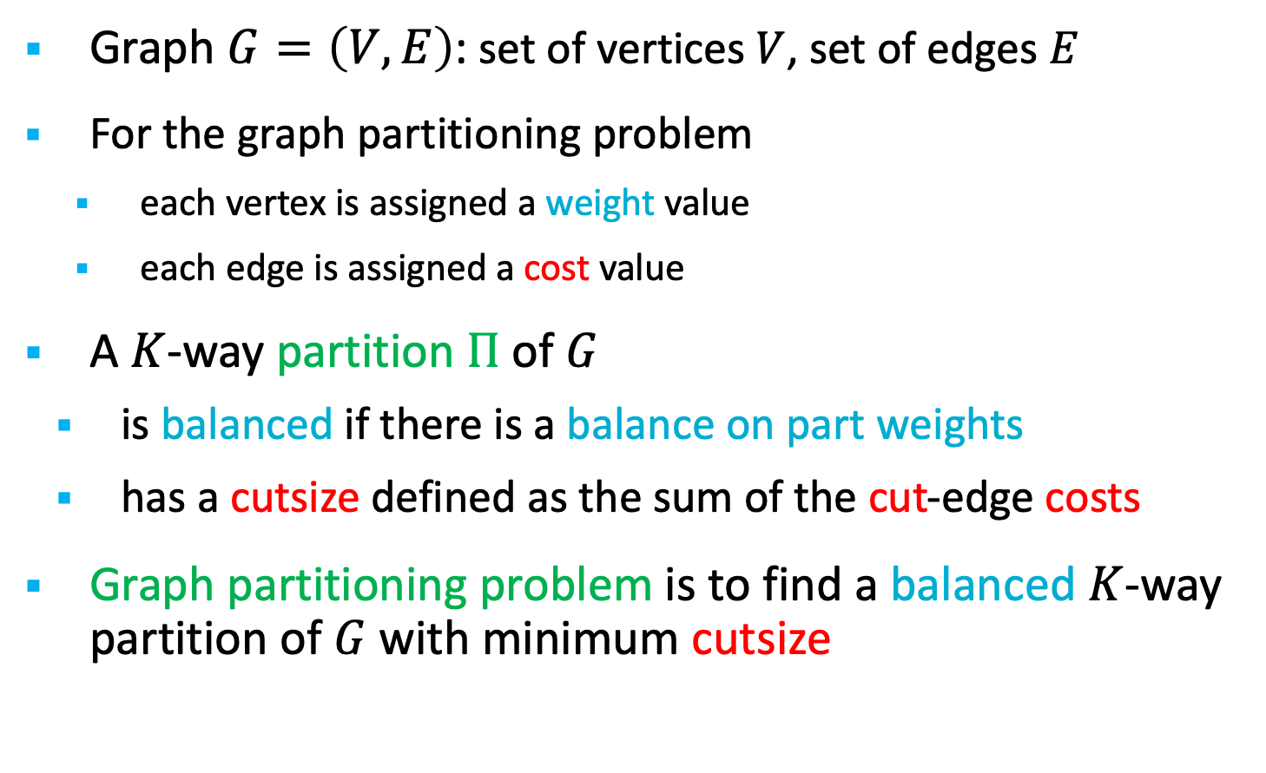
Sphynx – Problem Statement
Graph $G=\left(V,E\right)$: set of vertices $V$, set of edges $E$
For the graph partitioning problem
each vertex is assigned a weight value
each edge is assigned a cost value
A $K$-way partition $Π$ of $G$
is balanced if there is a balance on part weights
has a cutsize defined as the sum of the cut-edge costs
Graph partitioning problem is to find a balanced $K$-way partition of $G$ with minimum cutsize
6
1
3
2
1
Cutsize=3
3
5
1

Slide 4
Sphynx – Motivation
We are revisiting graph partitioning problem, because:
Applications are moving to accelerators
DoE facilities have announced different accelerators
AMD, Intel, NVIDIA GPUs
No accelerator-enabled graph partitioning tool exists
We provide Sphynx to fill this gap
Distributed-memory parallel, accelerator-enabled, and portable
Sphynx is based on a spectral approach, because:
Spectral methods use linear-algebra kernels, which are more amenable to parallelization on accelerators
Can potentially speed up algorithm with randomized linear algebra

Slide 5
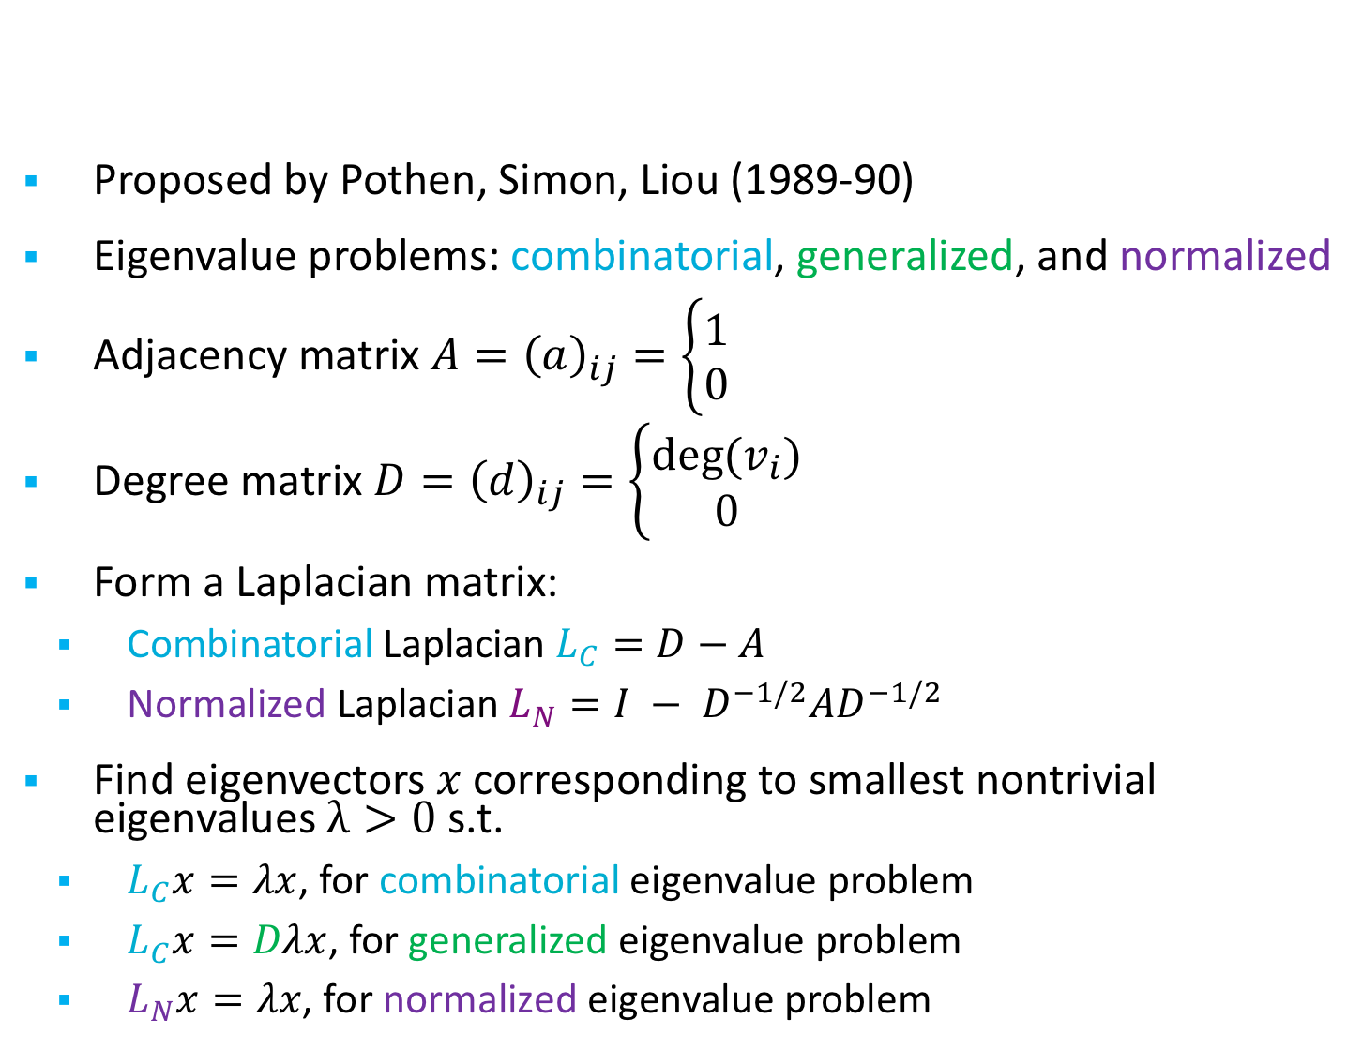
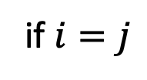
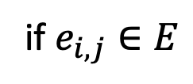
Background: Spectral partitioning
Proposed by Pothen, Simon, Liou (1989-90)
Eigenvalue problems: combinatorial, generalized, and normalized
Adjacency matrix $A={\left(a\right)}_{ij}=\left\{\begin{aligned}1 \\ 0\end{aligned}\right.$
Degree matrix $D={\left(d\right)}_{ij}=\left\{\begin{aligned}deg⁡(v_{i}) \\ 0\end{aligned}\right.$
Form a Laplacian matrix:
Combinatorial Laplacian $L_{C}=D−A$
Normalized Laplacian $L_{N}=I − D^{−1/2}AD^{−1/2}$
Find eigenvectors $x$ corresponding to smallest nontrivial eigenvalues $λ>0$ s.t.
$L_{C}x=λx$, for combinatorial eigenvalue problem
$L_{C}x=Dλx$, for generalized eigenvalue problem
$L_{N}x=λx$, for normalized eigenvalue problem
if $e_{i,j}∈E$
otherwise
if $i=j$
otherwise

Slide 6
Why Revisit Spectral Methods Now?
Weren’t they abandoned in the ‘90s and replaced by multilevel methods? Yes, but…
Quality of spectral partitioners are often only slightly worse than multilevel.
Preconditioned eigensolvers (LOBPCG) came later.
Linear algebra operations have been optimized for GPU.
Spectral partitioning is robust for large #proc (#GPU), as eigenvectors don’t change

Slide 7
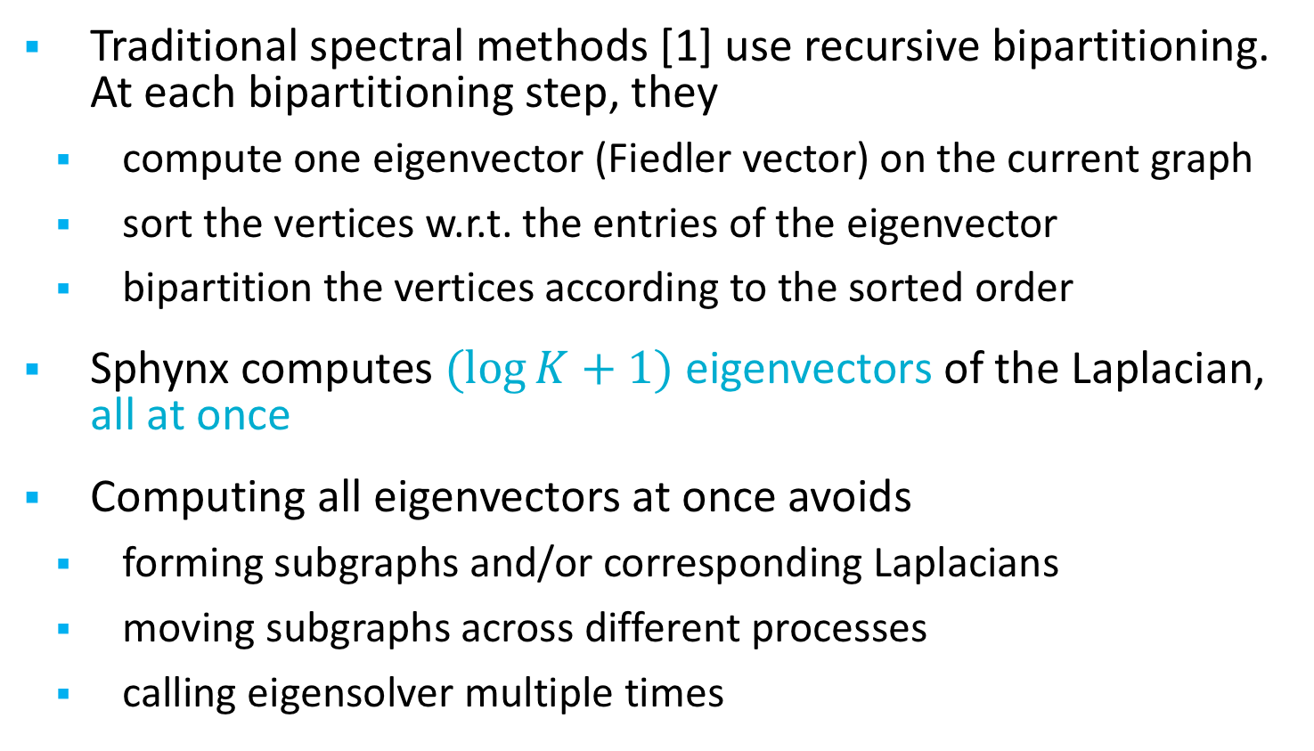
Sphynx – Spectral partitioning
Traditional spectral methods [1] use recursive bipartitioning. At each bipartitioning step, they
compute one eigenvector (Fiedler vector) on the current graph
sort the vertices w.r.t. the entries of the eigenvector
bipartition the vertices according to the sorted order
Sphynx computes $(log{K+1)}$ eigenvectors of the Laplacian, all at once
Computing all eigenvectors at once avoids
forming subgraphs and/or corresponding Laplacians
moving subgraphs across different processes
calling eigensolver multiple times
[1]
A. Pothen, H. Simon, and K. Liou, “Partitioning sparse matrices with eigenvectors of graphs,” SIAM J. Matrix Anal., vol. 11, pp. 430–452, July 1990.

Slide 8
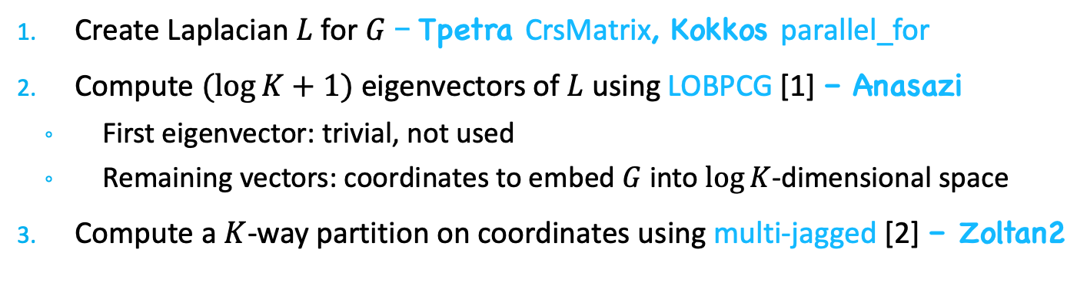
Sphynx – Trilinos framework
Create Laplacian $L$ for $G$ – Tpetra CrsMatrix, Kokkos parallel_for
Compute $(log{K}+1)$ eigenvectors of $L$ using LOBPCG [1] – Anasazi
First eigenvector: trivial, not used
Remaining vectors: coordinates to embed $G$ into $\log{K}$-dimensional space
Compute a $K$-way partition on coordinates using multi-jagged [2] – Zoltan2
1 & 2
3
[1]
A. V. Knyazev,“Toward the optimal preconditioned eigensolver: Locally optimal block preconditioned conjugate gradient method,” SIAM Journal on Scientific Computing, vol. 23, no. 2, pp. 517–541, 2001.
[2]
M. Deveci, S. Rajamanickam, K. D. Devine, and U. V. Catalyurek, “Multi-jagged: A scalable parallel spatial partitioning algorithm,” IEEE Transactions on Parallel and Distributed Systems, vol. 27, pp. 803–817, March 2016.

Slide 9
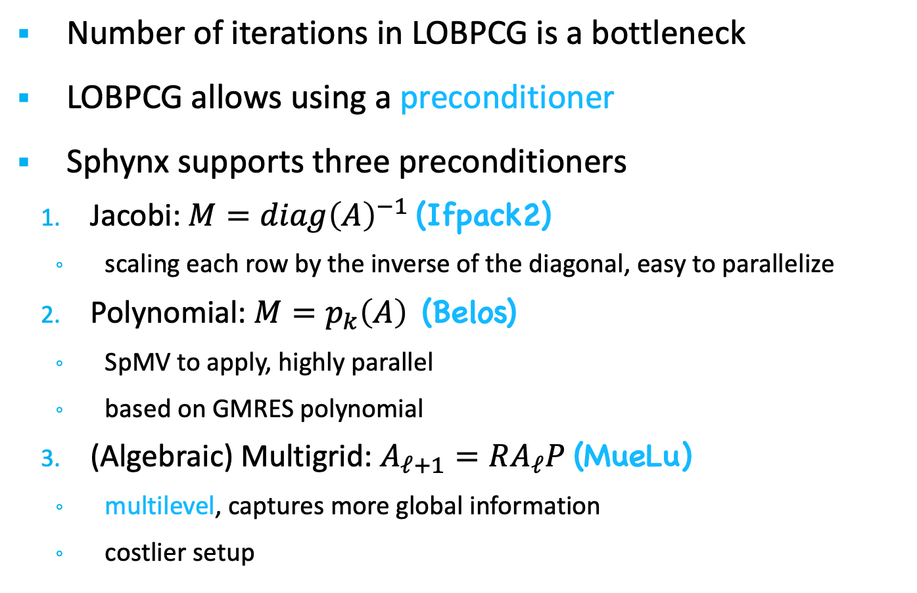
Sphynx – Preconditioning
Number of iterations in LOBPCG is a bottleneck
LOBPCG allows using a preconditioner
Sphynx supports three preconditioners
Jacobi: $M=diag{\left(A\right)}^{−1}$ (Ifpack2)
scaling each row by the inverse of the diagonal, easy to parallelize
Polynomial: $M=p_{k}\left(A\right)$ (Belos)
SpMV to apply, highly parallel
based on GMRES polynomial
(Algebraic) Multigrid: $A_{ℓ+1}=RA_{ℓ}P$ (MueLu)
multilevel, captures more global information
costlier setup

Slide 10
Sphynx – Experiments
The GPU focus: MPI+Kokkos (Cuda/HIP)
Performed on Summit and used 24 GPUs
Desired number of parts = K = 24
Each GPU is exclusively used by one MPI rank (default)
Device allocations in the Unified Virtual Memory (default)
Initial distribution of the test graphs: 1D block
This is the default distribution with Tpetra CrsMatrix
Parameter sensitivity and comparison against the state of the art
Performance metrics: cutsize and runtime

Slide 11
Sphynx – Dataset
graph | #vertices | #edges | degree
 |  |  | max | avg
ecology1 | 1,000,000 | 4,996,000 | 5 | 5
dielFilterV2real | 1,157,456 | 48,538,952 | 110 | 42
thermal2 | 1,227,087 | 8,579,355 | 11 | 7
Bump_2911 | 2,852,430 | 127,670,910 | 195 | 45
Queen_4147 | 4,147,110 | 329,499,284 | 81 | 79
100^3 | 1,000,000 | 26,463,592 | 27 | 26
200^3 | 8,000,000 | 213,847,192 | 27 | 27
400^3 | 64,000,000 | 1,719,374,392 | 27 | 27
hollywood-2009 | 1,069,126 | 113,682,432 | 11,468 | 106
com-Orkut | 3,072,441 | 237,442,607 | 33,314 | 77
wikipedia-20070206 | 3,512,462 | 88,261,228 | 187,672 | 25
cit-Patents | 3,764,117 | 36,787,597 | 794 | 10
com-LiveJournal | 3,997,962 | 73,360,340 | 14,816 | 18
wb-edu | 8,863,287 | 97,233,789 | 25,782 | 11
uk-2005 | 39,252,879 | 1,602,132,663 | 1,776,859 | 41
it-2004 | 41,290,577 | 2,096,240,367 | 1,326,745 | 51
twitter7 | 41,652,230 | 2,446,678,322 | 2,997,488 | 59
com-Friendster | 65,608,366 | 3,677,742,636 | 5,215 | 56
FullChip | 2,986,914 | 26,621,906 | 2,312,481 | 9
circuit5M | 5,555,791 | 59,519,031 | 1,290,501 | 11
regular
irregular
The SuiteSparse Matrix Collection, https://sparse.tamu.edu/

Slide 12
Sphynx – Results
Comparison against ParMETIS [1] and XtraPuLP [2]
ParMETIS and XtraPuLP do not run on GPUs
Application-friendly comparison on 24 MPI ranks
Sphynx uses 6 MPI ranks per node and 1 GPU per rank
ParMETIS uses 6 MPI ranks per node
XtraPuLP uses 6 MPI ranks per node and 7 OpenMP threads per rank
Average results normalized w.r.t Sphynx
 | ParMETIS |  | XtraPuLP
 | runtime | cutsize | runtime | cutsize
regular | 0.33 | 0.81 | 0.31 | 6.36
irregular | 23.95 | 0.30 | 1.24 | 0.45
ParMETIS execution did not finish in 2 hours on 4 graphs
Largest irregular graphs: uk-2005, it-2004, twitter7, com-Friendster
[1]
G. Karypis, V. Kumar, Parmetis: Parallel graph partitioning and sparse matrix ordering library, Tech. rep., Dept. Computer Science, University of Minnesota, 1997.
G. M. Slota, S. Rajamanickam, K. Devine, K. Madduri, Partitioning trillion-edge graphs in minutes, IPDPS, 2017.
[2]

Slide 13
Randomized Eigensolvers
The most expensive phase (90-95%) in spectral partitioning is the eigensolver
Fairly low accuracy is sufficient to obtain good partitioning
Key idea: We can use a randomized eigensolver instead of LOBPCG
Randomized methods often get low-accuracy solutions very fast
We follow the approach in Halko, Martinsson, Tropp (20XX)
We have explored this approach in a prototype
HPC implementation in Trilinos/Sphynx still to do

Slide 14
Randomized Method: Phase 1
Here we will use the normalized Laplacian, L_{N}
We estimate the largest eigenvalues of the normalized adjacency matrix, which correspond to the smallest eigenvalues of L_{N}
First, we approximate the range of A_{N}, where A_{N} = D ^{-½} A D^{-½.}
Draw a random Gaussian (normal) matrix Ω
Form Y= A_{N} ^{q} Ω
Compute skinny QR: QR = Y

Slide 15
Randomized Method: Phase 2
Second, compute eigenvalues on the projected problem.
Compute projection B = Q^{T}AQ
Solve eigenproblem for B: B = V ƛ V^{T}
Project back: U= QV
We only need to solve a small, dense eigenproblem for B
Fast!
No longer need LOBPCG (or any sparse eigensolver)

Slide 16
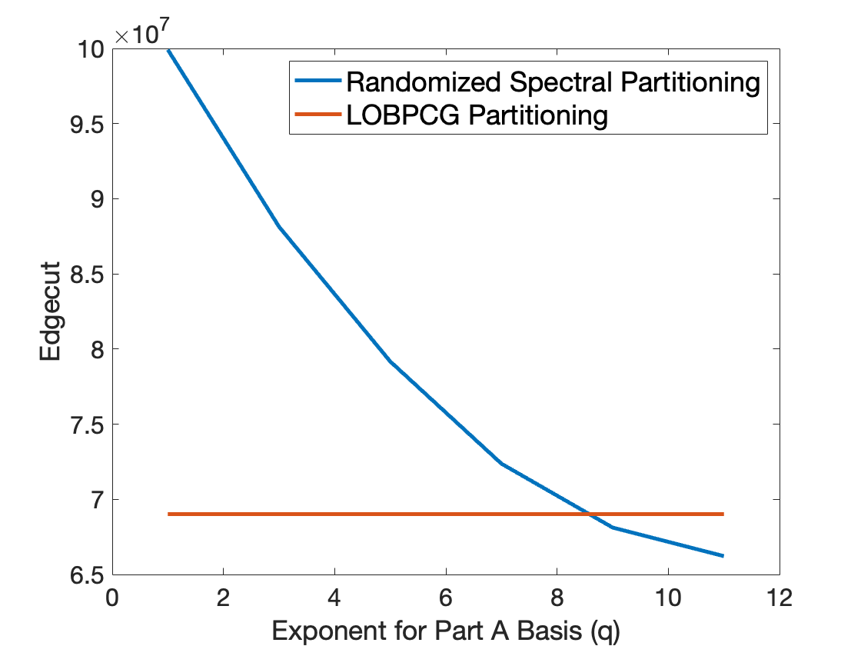
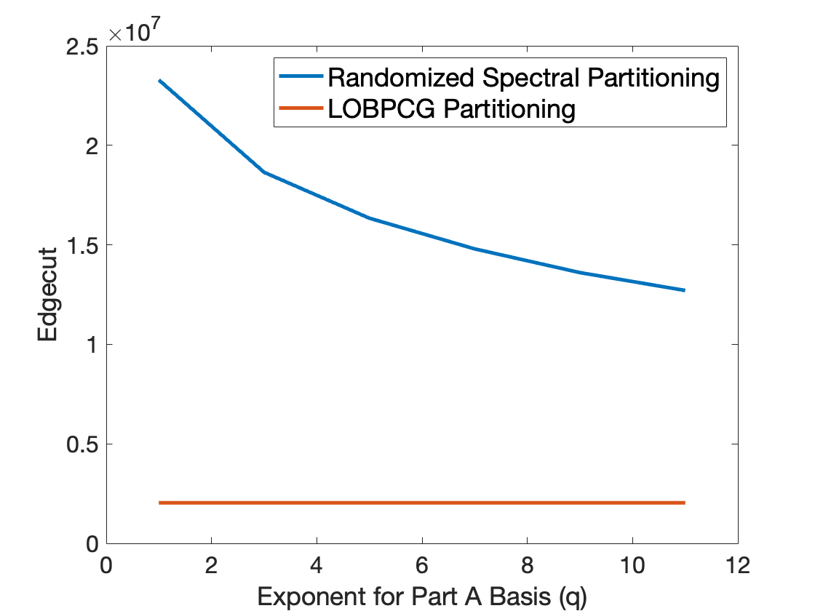
Randomized partitioning quality
Irregular: Hollywood
Regular: Brick3d
The randomized eigensolver actually works better than LOBPCG for partitioning with sufficiently large q (for irregular graphs)!

Slide 17
Results: Quality
Sphynx edge cuts with LOBPCG vs randomized solver with L=20.
Matrix | LOBPCG | q=1 | q=3 | q=5 | q=7 | q=9 | q=11
cube100 | 2,036,942 | 23,280,878 | 18,643,406 | 16,339,232 | 14,763,242 | 13,620,082 | 12,645,466
hollywood | 69,010,728 | 99,913,222 | 88,136,872 | 79,170,890 | 72,369,774 | 68,120,278 | 66,220,826
wikipedia | 70,372,336 | 82,607,424 | 80,328,958 | 77,783,740 | 74,965,720 | 71,660,478 | 69,205,042
FullChip | 19,837,100 | 21,925,964 | 18,723,240 | 17,296,392 | 16,483,600 | 15,890,706 | 15,466,674
Circuit5M | 40,918,466 | 52,793,074 | 49,117,806 | 42,290,548 | 33,731,544 | 31,757,878 | 31,563,734
Randomized method (q=11) often gives lower (better) cuts than LOBPCG !

Slide 18
Results: Run Time
Sphynx run times (CPU) with LOBPCG vs randomized solver with L=20.
Matrix | LOBPCG | q=1 | q=3 | q=5 | q=7 | q=9 | q=11
cube100 | 18.19 | 1.601 | 2.185 | 2.779 | 3.357 | 3.907 | 4.465
hollywood | 360.6 | 5.865 | 10.88 | 15.69 | 20.44 | 25.33 | 30.35
wikipedia | 923.3 | 18.59 | 33.28 | 47.75 | 62.15 | 76.45 | 90.84
FullChip | 162.8 | 5.00 | 6.24 | 7.50 | 8.79 | 10.13 | 11.38
Circuit5M | 821.5 | 11.14 | 13.98 | 16.23 | 18.27 | 21.04 | 23.93
Our randomized method is 10X-80X faster (q=1) than LOBPCG!
Also much faster with q=11.

Slide 19
Conclusions
Randomized eigensolver can dramatically speed up (5-80X) a spectral partitioner
Works well for irregular graphs (e.g., web graphs) but not so well for more regular graphs (e.g., meshes)
Trade-off in computational cost vs quality
Sphynx has been released in Trilinos/Zoltan2
Randomized method will be released soon
All spectral methods have some weaknesses
Can benefit from multilevel methods and edge-cut refinement
Collaboration with K. Madduri and M. Gilbert (Penn State) will address this
Approach can be extended to spectral clustering
Is randomized linear algebra useful in other discrete problems?
This research was supported by the Exascale Computing Project (17-SC-20-SC), a collaborative effort of the U.S. Department of Energy Office of Science and the National Nuclear Security Administration.

Slide 20
Extra slides

Slide 21
Sphynx – Results
LOBPCG Convergence Tolerance:
Default: 1e-2 for MueLu
1e-3 for others
Default: 1e-2 for all

Slide 22
Sphynx – Results
Eigenvalue Problem:
Average results normalized w.r.t combinatorial
 | preconditioner | generalized |  | normalized
 |  | runtime | cutsize | runtime | cutsize
regular | Jacobi | 0.81 | 1.15 | 0.43 | 2.26
 | Polynomial | 0.73 | 1.21 | 0.54 | 2.45
 | MueLu | 0.99 | 1.12 | 0.95 | 2.20
irregular | Jacobi | 0.75 | 0.83 | 0.26 | 1.36
 | Polynomial | 0.36 | 0.84 | 0.02 | 0.83
 | MueLu | 0.71 | 0.90 | 0.31 | 1.68
Default: combinatorial for regular graphs,
generalized for irregular graphs with Jacobi and MueLu, and
normalized for irregular graphs with Polynomial.

Slide 23
Sphynx – Results
Preconditioner:
Average results normalized w.r.t. Jacobi
 | Polynomial |  | MueLu
 | runtime | cutsize | runtime | cutsize
regular | 0.46 | 1.03 | 0.42 | 0.91
irregular | 0.62 | 1.71 | 1.91 | 0.94
Suggested: MueLu for regular graphs,
Polynomial for irregular graphs.

Slide 24

Sphynx: Exascale Systems
Sphynx Running Time on OLCF systems:
Summit: Nvidia Volta V100
Spock: AMD MI200
RUNNING TIME (s)
 | Summit | Spock | Spock/Summit
ecology1 | 1.40 | 0.65 | 0.47
dielFilterV2real | 2.13 | 1.61 | 0.75
thermal2 | 1.78 | 1.22 | 0.69
Bump_2911 | 1.68 | 1.35 | 0.80
Queen_4147 | 2.20 | 1.61 | 0.73
100^3 | 1.39 | 0.97 | 0.70
200^3 | 2.11 | 1.78 | 0.84
400^3 | 6.78 | 7.75 | 1.14
geomean |  |  | 0.75
hollywood-2009 | 4.79 | 3.60 | 0.75
com-Orkut | 8.06 | 7.52 | 0.93
wikipedia-20070206 | 15.66 | 18.44 | 1.18
cit-Patents | 8.27 | 7.75 | 0.94
com-LiveJournal | 8.70 | 7.81 | 0.90
wb-edu | 5.54 | 6.55 | 1.18
uk-2005 | 89.31 | 137.59 | 1.54
it-2004 | 90.24 | 101.58 | 1.13
twitter7 | 482.85 | 499.43 | 1.03
com-Friendster | 186.16 | 135.20 | 0.73
FullChip | 48.36 | 77.56 | 1.60
circuit5M | 43.55 | 47.87 | 1.10
geomean |  |  | 1.05

